Slide 1
Welcome to Narcoossee Middle School

Slide 2
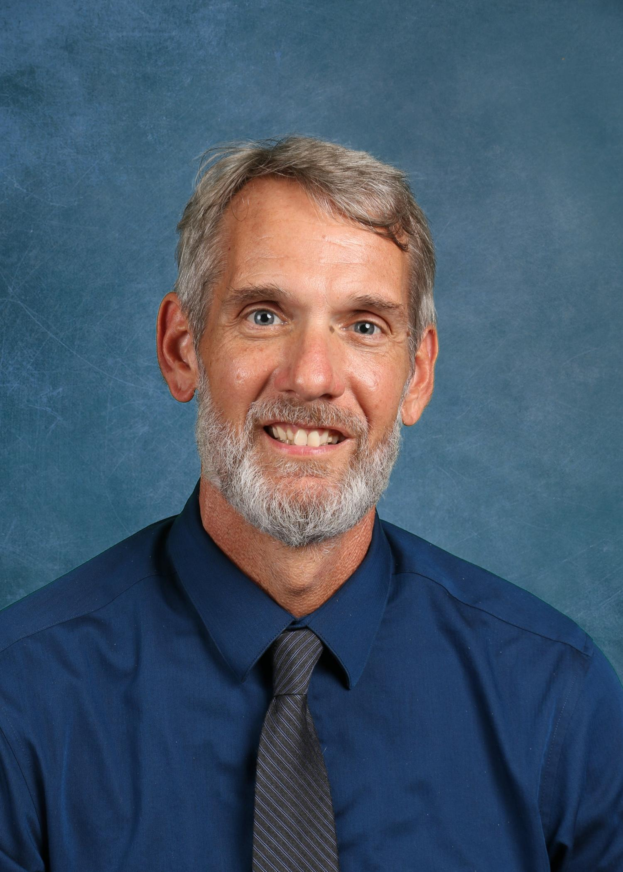
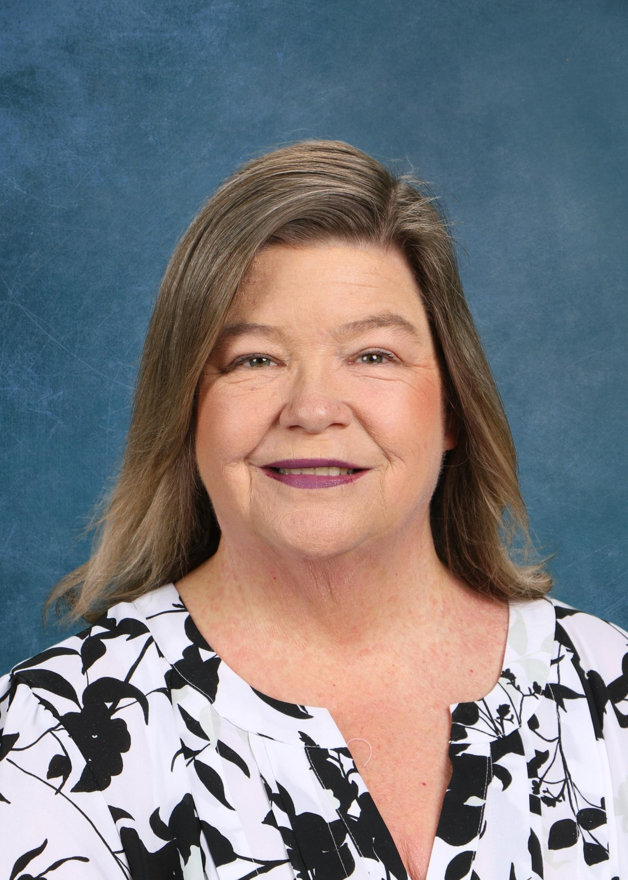
NCMS Administration
Mr. Weeden
Principal
Mrs. Mabra
Assistant Principal
Mrs. Schneider
Assistant Principal

Slide 3
PBIS – BEARS Expectations
We are proud to be a PBIS School!
Positive Behavior Interventions and Supports
NCMS Bears know, understand, and live the following expectations
B – Be Responsible
E – Encourage Others
A – Act Safely
R – Respect All
S – Strive for Success

Slide 4
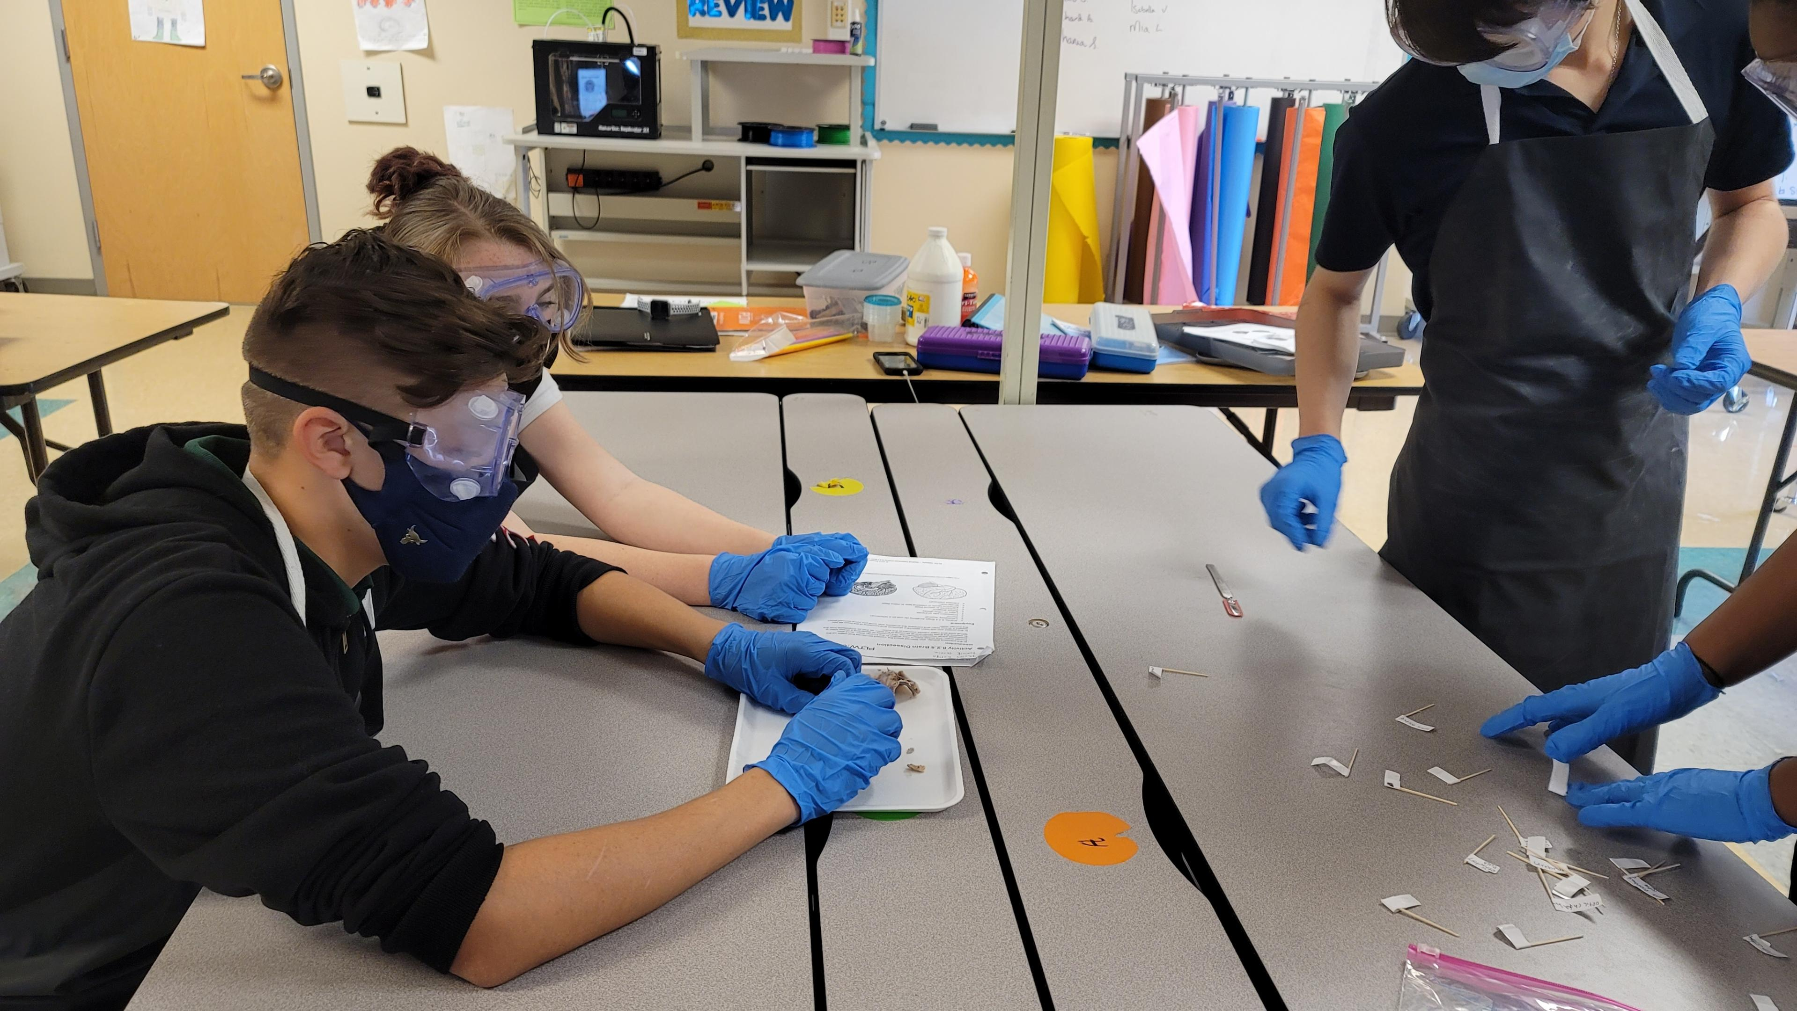
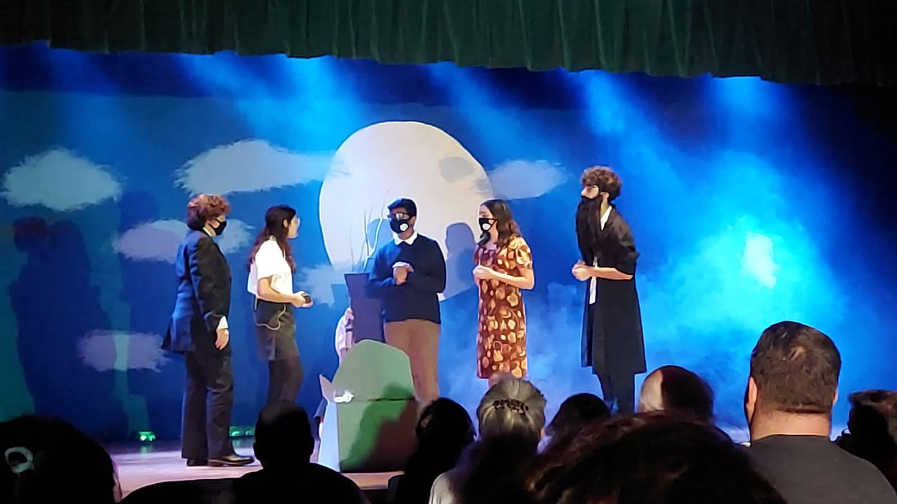
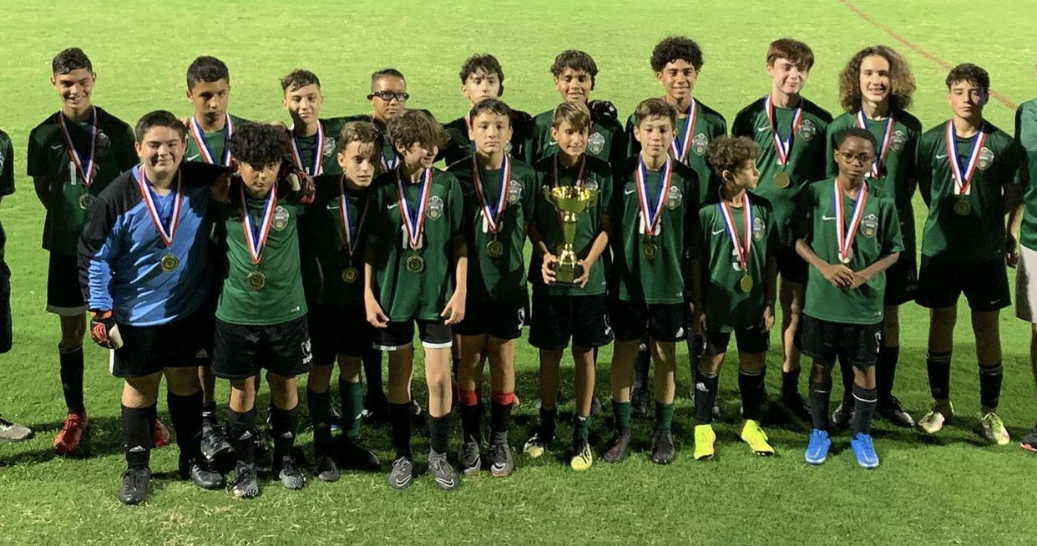
We are Narcoossee!
Great Place to Grow and Learn
Academics + Arts + Athletics = Successful and Well-Rounded Black Bear
AVID National Demonstration School

Slide 5
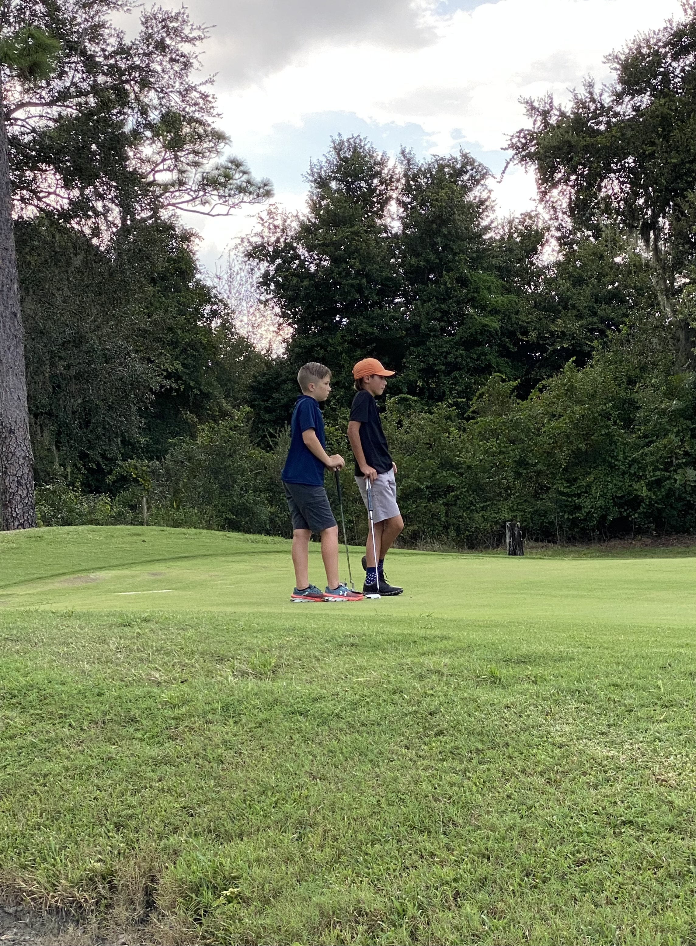
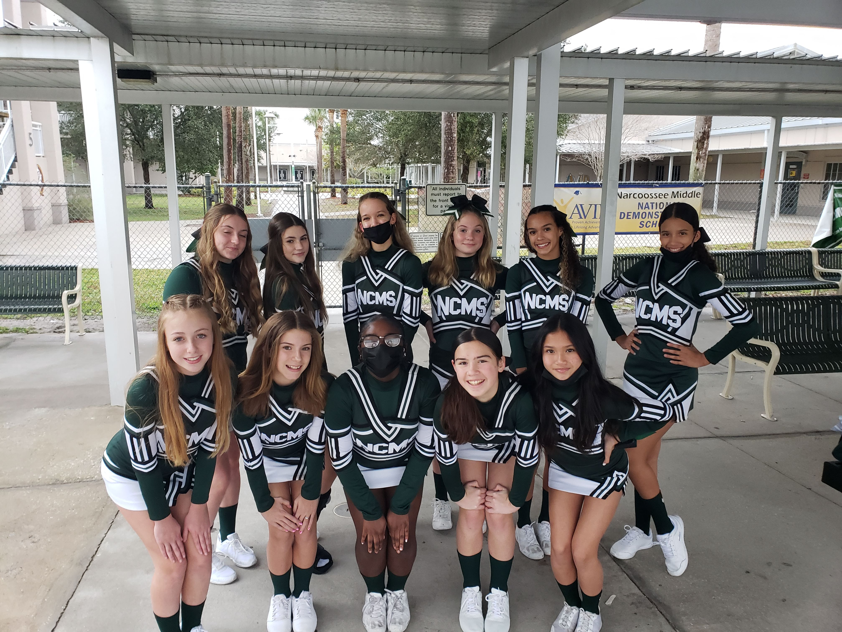
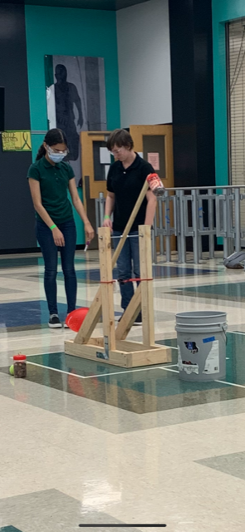
Extra Curricular Activities
Competitive Sports
Clubs
Basketball
Cheerleading
Cross-Country
Flag Football
Golf
Soccer
Softball
Track and Field
Volleyball
Battle of the Books
Fellowship of Christian Athletes
Odyssey of the Mind
Robotics
Science Olympiad

Slide 6
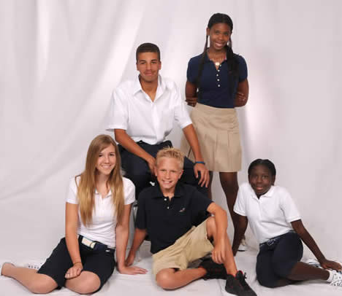
Dress Code
NCMS follows and adheres to the expectations in the School District of Osceola County’s Code of Student Conduct
Polo Colors
Hunter Green
Black
Light Pink
White
Navy Blue
Bottoms
Dark Blue, Black, Khaki
Denim (Jeans), Twill, Corduroy
Shoes
Athletic shoes only
Closed Toe/Heel
Outerwear
Button-up or zippered

Slide 7
Your Personal School Schedule
Core classes which include Language Arts, Math, Reading, Science, and Social Studies are scheduled first and are based on assessment scores and teacher recommendations.
Electives are scheduled for students after core classes have been placed into the schedule. Student elective choices are a request and are not guaranteed.

Slide 8
An Example of a Finalized Schedule
1st Reading (Research, Intensive Reading or AVID)
2nd Language Arts (Lang Arts 1, Adv)
3^{rd Elective 1}
4^{th Math (Math, Adv)}
5^{th Lunch}
6^{th Science (Earth Sci, Adv)}
7^{th Elective 2}
8th Social Studies (World History, Adv or US History, Adv)

Slide 9
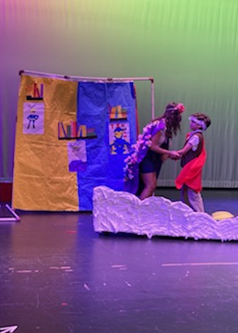
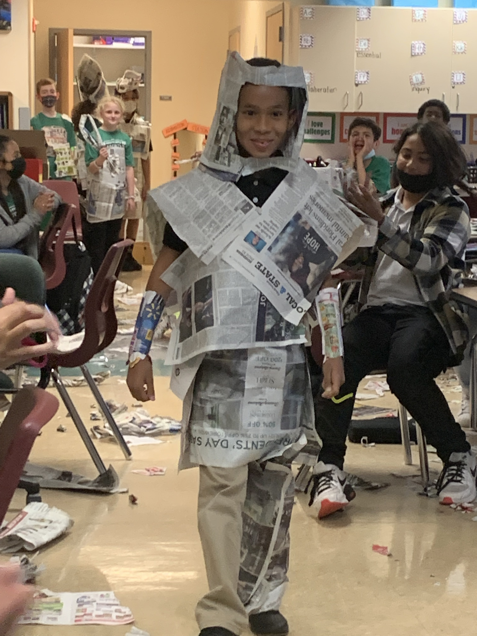
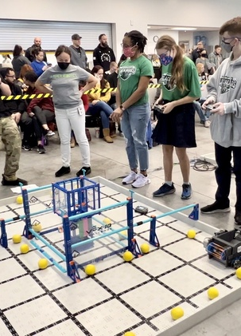
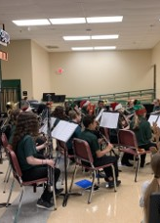
Elective offerings
AVID
Art
Band
Chorus
Computer Applications
Orchestra
PE
STEM (Design and Modeling)
Spanish
Theatre/Musical Theatre

Slide 10
AVID – Full Year Advancement Via Individual Determination
Must complete an application
Learn how to be college ready
Organizational skills
Study skills
Note taking strategies

Slide 11
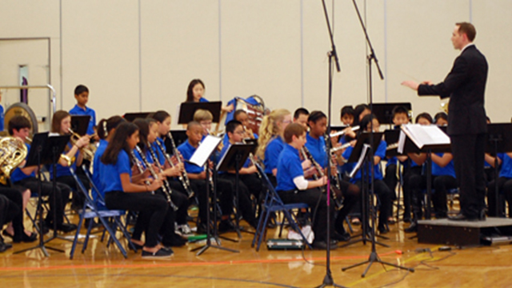
Band – Full Year
To learn a new instrument
May need to rent or purchase an instrument
Need to practice the instrument at home
Students will preform in Winter and Spring concerts

Slide 12
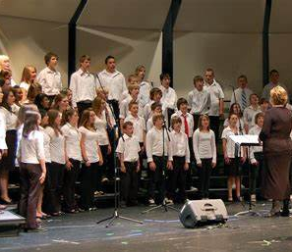
Chorus – Full Year
Basic vocal Music Instruction (Sing)
Will perform in winter and spring concerts

Slide 13
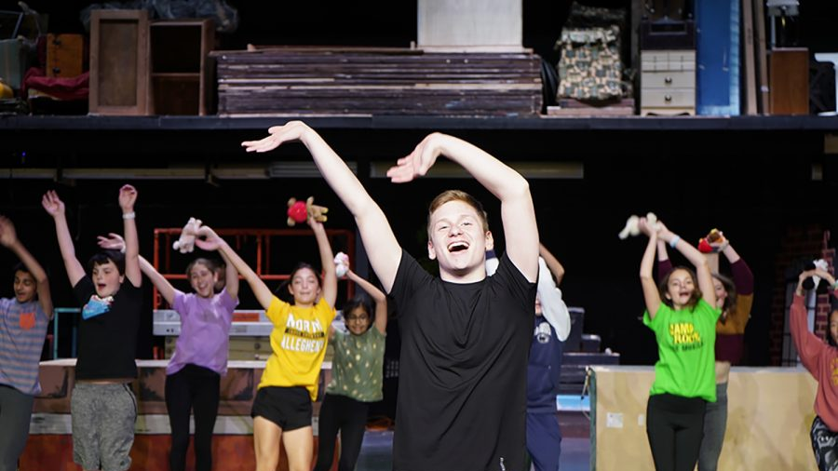
Musical Theatre – Full Year
Explores basic acting
Basic vocal performances
Basic dance/movement and staging

Slide 14
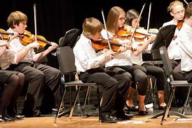
Orchestra – Full Year
Need to learn a new instrument
May need to rent or purchase an instrument
Need to practice the instrument at home
Students will preform in Winter and Spring concerts

Slide 15
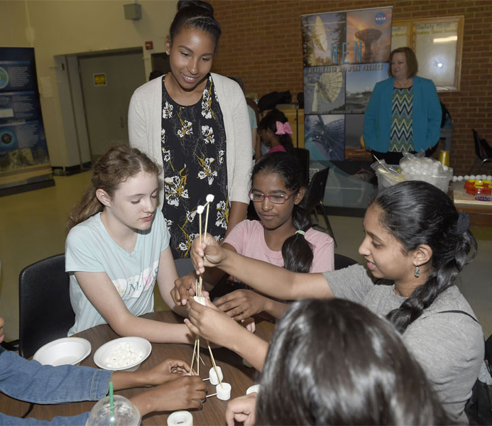
6th Grade STEM – Full Year
Will cover engineering design and science behind technology
Can take Robotics in 7th or 8th grade

Slide 16
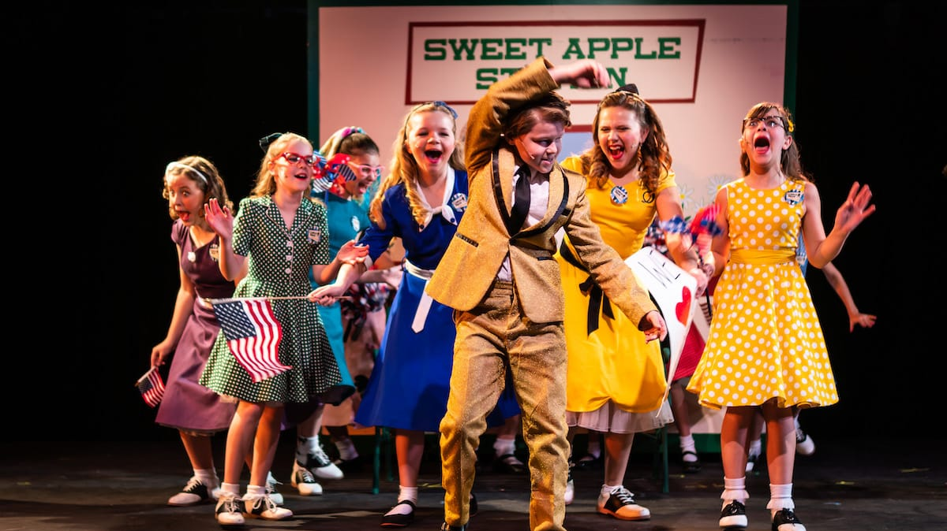
Acting/Drama Half Year
Explores theatre’s social and cultural influences
Performance in front of peers
Memorizing lines

Slide 17
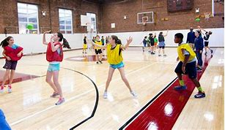
Physical Education Half Year
Active participation course which demonstrates wide variety of skills.
Must purchase uniform and dress out each day.

Slide 18
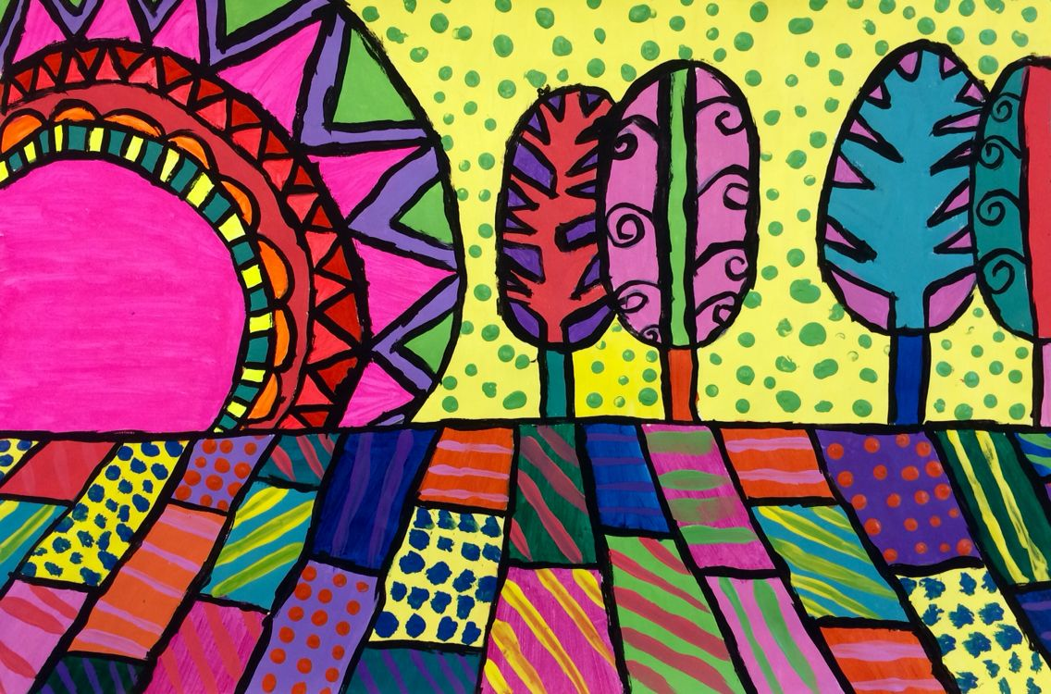
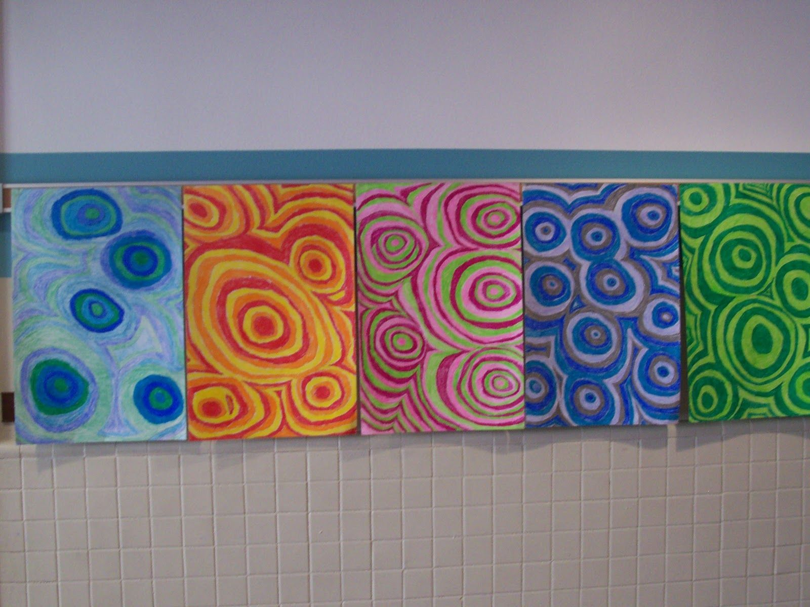
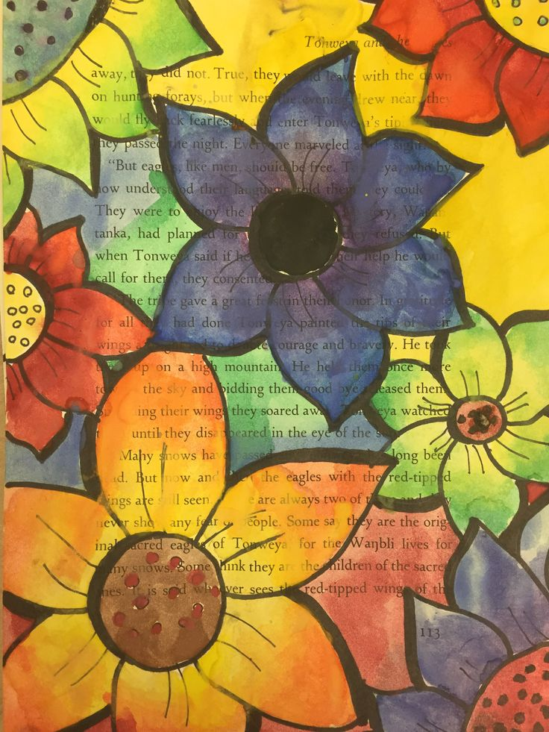
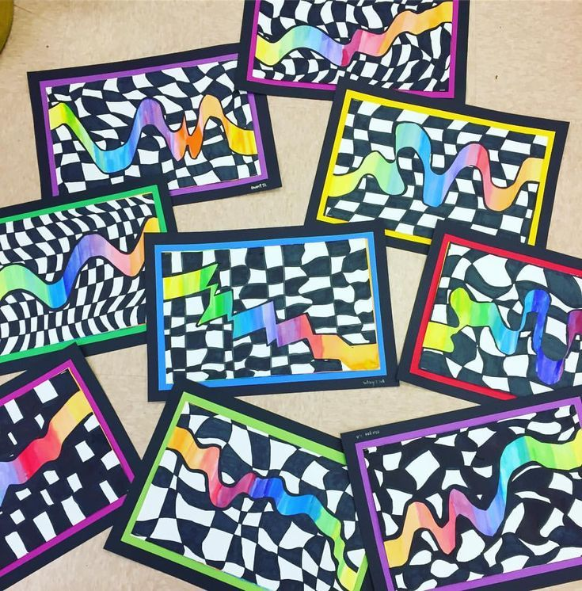
Visual Art - Half Year
Basic art
Learn different techniques
Different brushes
Color patterns
Be creative

Slide 19
Understanding Music - Half Year
Basic Musical knowledge
No instrument required
Learn about music
Writing music
Perform in front of peers

Slide 20
Exploratory Spanish - Half Year
Basic Spanish
Not High School credit

Slide 21
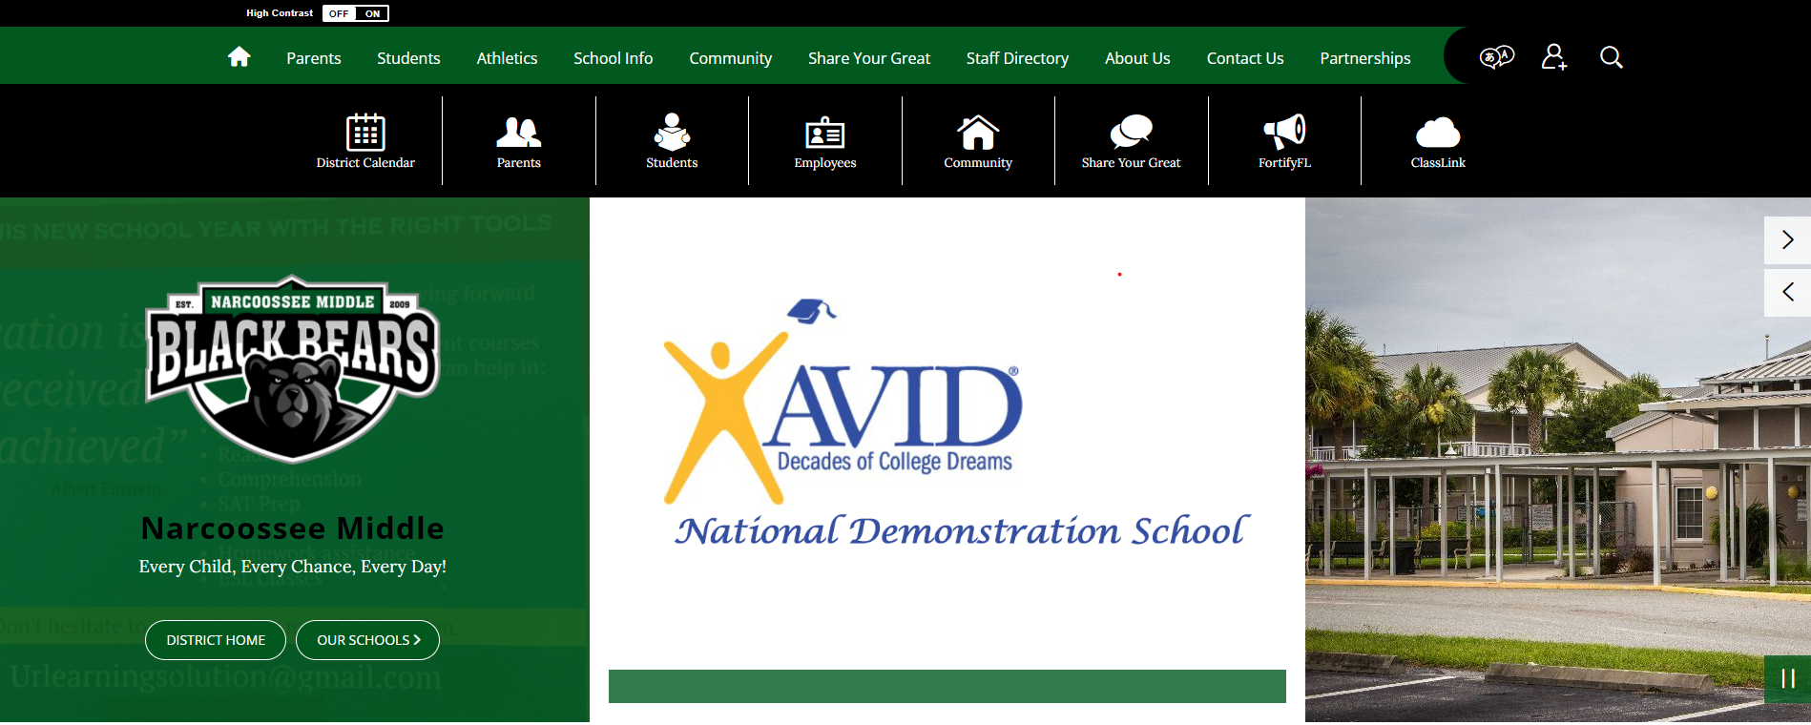
NCMS Website--osceolaschools.net/ncms

Slide 22
osceolaschools.net/ncms

